Slide 1
Asymptotic Notation
Topic 1.1.1

Slide 2
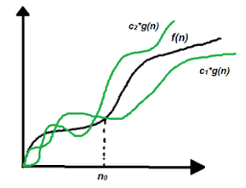
Asymptotic Complexity
Running time of an algorithm as a function of input size n for large n.
Expressed using only the highest-order term in the expression for the exact running time.
Instead of exact running time, say Θ(n²).
Describes behavior of function in the limit.
Written using Asymptotic Notation.

Slide 3
Asymptotic Notation
Θ, O, Ω, o, ω
Defined for functions over the natural numbers.
Ex: f(n) = Θ(n²).
Describes how f(n) grows in comparison to n².
Define a set of functions; in practice used to compare two function sizes.
The notations describe different rate-of-growth relations between the defining function and the defined set of functions.

Slide 4
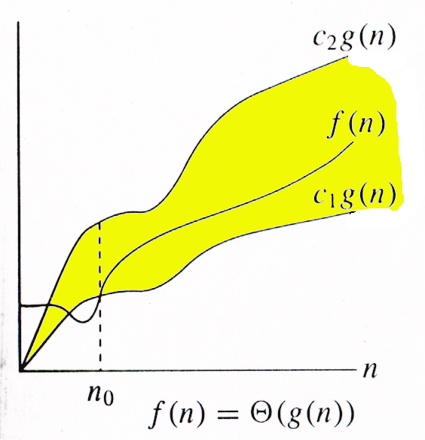
Θ-notation
For function g(n), we define Θ(g(n)), big-Theta of n, as the set:
Θ(g(n)) = {f(n) : ∃ positive constants c₁, c₂, and n_{0,} such that ∀n ≥ n₀,
we have 0 ≤ c₁g(n) ≤ f(n) ≤ c₂g(n)
}
Intuitively: Set of all functions that
have the same rate of growth as g(n).
g(n) is an asymptotically tight bound for f(n).

Slide 5
Θ-notation
For function g(n), we define Θ(g(n)), big-Theta of n, as the set:
Θ(g(n)) = {f(n) : ∃ positive constants c₁, c₂, and n_{0,} such that ∀n ≥ n₀,
we have 0 ≤ c₁g(n) ≤ f(n) ≤ c₂g(n)
}
Technically, f(n) ∈ Θ(g(n)).
Older usage, f(n) = Θ(g(n)).
I’ll accept either…
f(n) and g(n) are nonnegative, for large n.

Slide 6
Exercise
Express functions in A in asymptotic notation using functions in B.
A B
1. 5n² + 100n 3n² + 2
A ∈ Θ(B)
A ∈ Θ(n²), n² ∈ Θ(B) ⇒ A ∈ Θ(B)
2. log₃(n²) log₂(n³)
A ∈ Θ(B)
log_{b}a = log_{c}a / log_{c}b; A = 2lgn / lg3, B = 3lgn, A/B =2/(3lg3)
3. n^{lg4} 3^{lg n}
A ∈ ω(B)
a^{log b} = b^{log a}; B =3^{lg n}=n^{lg 3}; A/B =n^{lg(4/3)} → ∞ as n→∞
4. lg²n n^{1/2}
A ∈ ο (B)
lim ( lgª n / n^{b} ) = 0 (here a = 2 and b = 1/2) ⇒ A ∈ ο (B)
^{n→∞}

Slide 7
Example
Θ(g(n)) = {f(n) : ∃ positive constants c₁, c₂, and n₀, such that ∀n ≥ n₀, 0 ≤ c₁g(n) ≤ f(n) ≤ c₂g(n)}
What constants for n₀, c₁, and c₂ will work?
10n² - 3n = Θ(n²)
Make c₁ a little smaller than the leading coefficient, and c₂ a little bigger.
To compare orders of growth, look at the leading term.
Practice question: Prove that n²/2-3n= Θ(n²)

Slide 8
Example
Θ(g(n)) = {f(n) : ∃ positive constants c₁, c₂, and n₀, such that ∀n ≥ n₀, 0 ≤ c₁g(n) ≤ f(n) ≤ c₂g(n)}
Is 3n³ ∈ Θ(n⁴) ??
How about 2^{2n}∈ Θ(2^{n})??
Note: The above questions can be solved by taking c1 and c2 values.

Slide 9
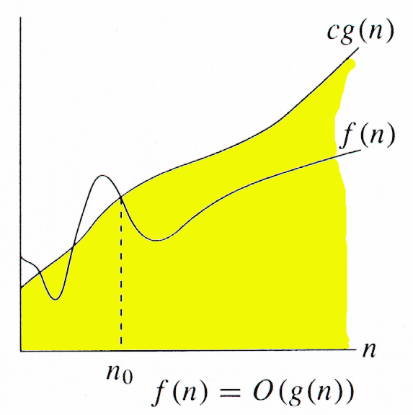
O-notation
For function g(n), we define O(g(n)), big-O of n, as the set:
O(g(n)) = {f(n) : ∃ positive constants c and n_{0,} such that ∀n ≥ n₀,
we have 0 ≤ f(n) ≤ cg(n) }
Intuitively: Set of all functions whose rate of growth is the same as or lower than that of g(n).
g(n) is an asymptotic upper bound for f(n).
f(n) = Θ(g(n)) ⇒ f(n) = O(g(n)).
Θ(g(n)) ⊂ O(g(n)).

Slide 10
Examples
O(g(n)) = {f(n) : ∃ positive constants c and n₀, such that ∀n ≥ n₀, we have 0 ≤ f(n) ≤ cg(n) }
Any linear function an + b is in O(n²). How?
Show that 3n³=O(n⁴) for appropriate c and n₀.

Slide 11
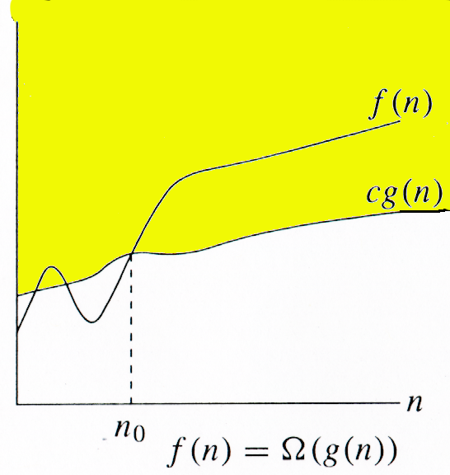
Ω -notation
For function g(n), we define Ω(g(n)), big-Omega of n, as the set:
Ω(g(n)) = {f(n) : ∃ positive constants c and n_{0,} such that ∀n ≥ n₀,
we have 0 ≤ cg(n) ≤ f(n)}
Intuitively: Set of all functions whose rate of growth is the same as or higher than that of g(n).
g(n) is an asymptotic lower bound for f(n).

Slide 12
Example
Ω(g(n)) = {f(n) : ∃ positive constants c and n₀, such that ∀n ≥ n₀, we have 0 ≤ cg(n) ≤ f(n)}
√n = Ω(lg n). Choose c and n₀.

Slide 13
Relations Between Θ, O, Ω

Slide 14
Relations Between Θ, Ω, O
Theorem : For any two functions g(n) and f(n), f(n) = Θ(g(n)) iff
f(n) = O(g(n)) and f(n) = Ω(g(n)).
I.e., Θ(g(n)) = O(g(n)) ∩ Ω(g(n))
In practice, asymptotically tight bounds are obtained from asymptotic upper and lower bounds.

Slide 15
Running Times
“Running time is O(f(n))” ⇒ Worst case is O(f(n))
O(f(n)) bound on the worst-case running time ⇒ O(f(n)) bound on the running time of every input.
Θ(f(n)) bound on the worst-case running time ⇒ Θ(f(n)) bound on the running time of every input.
“Running time is Ω(f(n))” ⇒ Best case is Ω(f(n))
Can still say “Worst-case running time is Ω(f(n))”
Means worst-case running time is given by some unspecified function g(n) ∈ Ω(f(n)).

Slide 16
Example
Insertion sort takes Θ(n²) in the worst case, so sorting (as a problem) is O(n²).
Any sort algorithm must look at each item, so sorting is Ω(n).
In fact, using (e.g.) merge sort, sorting is Θ(n lg n) in the worst case.

Slide 17
Asymptotic Notation in Equations
Can use asymptotic notation in equations to replace expressions containing lower-order terms.
For example,
4n³ + 3n² + 2n + 1 = 4n³ + 3n² + Θ(n)
= 4n³ + Θ(n²) = Θ(n³).
In equations, Θ(f(n)) always stands for an anonymous function g(n) ∈ Θ(f(n))
In the example above, Θ(n²) stands for 3n² + 2n + 1.

Slide 18
o-notation
For a given function g(n), the set little-o:
o(g(n)) = {f(n): ∀ c > 0, ∃ n₀ > 0 such that ∀ n ≥ n₀, we have 0 ≤ f(n) < cg(n)}.
f(n) becomes insignificant relative to g(n) as n approaches infinity:
lim [f(n) / g(n)] = 0
^{n→∞}
g(n) is an upper bound for f(n) that is not asymptotically tight.

Slide 19
ω -notation
For a given function g(n), the set little-omega:
ω(g(n)) = {f(n): ∀ c > 0, ∃ n₀ > 0 such that ∀ n ≥ n₀, we have 0 ≤ cg(n) < f(n)}.
f(n) becomes arbitrarily large relative to g(n) as n approaches infinity:
lim [f(n) / g(n)] = ∞.
^{n→∞}
g(n) is a lower bound for f(n) that is not asymptotically tight.

Slide 20
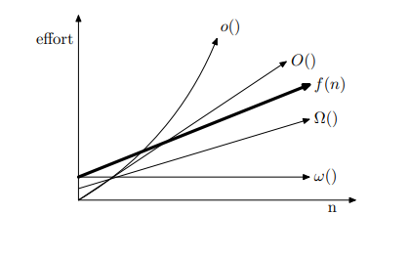
Relationships between these notations:

Slide 21
Comparison of Functions
f ↔ g ≈ a ↔ b
f (n) = O(g(n)) ≈ a ≤ b
f (n) = Ω(g(n)) ≈ a ≥ b
f (n) = Θ(g(n)) ≈ a = b
f (n) = o(g(n)) ≈ a < b
f (n) = ω (g(n)) ≈ a > b

Slide 22
Limits
lim [f(n) / g(n)] = 0 ⇒ f(n) ∈ ο(g(n))
^{n→∞}
lim [f(n) / g(n)] < ∞ ⇒ f(n) ∈ Ο(g(n))
^{n→∞}
0 < lim [f(n) / g(n)] < ∞ ⇒ f(n) ∈ Θ(g(n))
^{n→∞}
0 < lim [f(n) / g(n)] ⇒ f(n) ∈ Ω(g(n))
^{n→∞}
lim [f(n) / g(n)] = ∞ ⇒ f(n) ∈ ω(g(n))
^{n→∞}
lim [f(n) / g(n)] undefined ⇒ can’t say
^{n→∞}

Slide 23
Properties
Transitivity
f(n) = Θ(g(n)) & g(n) = Θ(h(n)) ⇒ f(n) = Θ(h(n))
f(n) = O(g(n)) & g(n) = O(h(n)) ⇒ f(n) = O(h(n))
f(n) = Ω(g(n)) & g(n) = Ω(h(n)) ⇒ f(n) = Ω(h(n))
f(n) = o (g(n)) & g(n) = o (h(n)) ⇒ f(n) = o (h(n))
f(n) = ω(g(n)) & g(n) = ω(h(n)) ⇒ f(n) = ω(h(n))
Reflexivity
f(n) = Θ(f(n))
f(n) = O(f(n))
f(n) = Ω(f(n))

Slide 24
Properties
Symmetry
f(n) = Θ(g(n)) iff g(n) = Θ(f(n))
Complementarity
f(n) = O(g(n)) iff g(n) = Ω(f(n))
f(n) = o(g(n)) iff g(n) = ω((f(n))

Slide 25
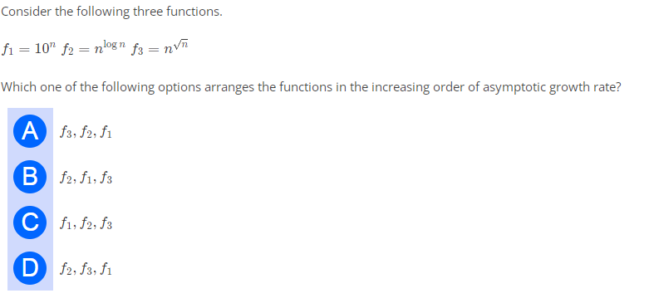
Practice Question

Slide 26
Common Functions : Important Theorems

Slide 27
Monotonicity
f(n) is
monotonically increasing if m ≤ n ⇒ f(m) ≤ f(n).
monotonically decreasing if m ≥ n ⇒ f(m) ≥ f(n).
strictly increasing if m < n ⇒ f(m) < f(n).
strictly decreasing if m > n ⇒ f(m) > f(n).
Monotonically increasing means when a function is said to be monotonically increasing if its graph is only increasing with increasing values of the equation.
If f′(x)>0 for all x in the interval, then the function f is strictly increasing. If f′(x)<0 for all x in the interval, then the function f is strictly decreasing.

Slide 28
Exponentials
Useful Identities:
Exponentials and polynomials

Slide 29
Logarithms
x = log_{b}a is the exponent for a = b^{x}.
Natural log: ln a = log_{e}a
Binary log: lg a = log₂a
lg²a = (lg a)²
lg lg a = lg (lg a)

Slide 30
Logarithms and exponentials – Bases
If the base of a logarithm is changed from one constant to another, the value is altered by a constant factor.
Ex: log₁₀ n * log₂10 = log₂ n.
Base of logarithm is not an issue in asymptotic notation.
Exponentials with different bases differ by a exponential factor (not a constant factor).
Ex: 2^{n} = (2/3)^{n}*3^{n}.

Slide 31
Polylogarithms
Polylogarithms: An algorithm is said to run in polylogarithmic time if T(n) = O((log n)k), for some constant k. For example: Matrix chain ordering. For eg, [O((log(n))^c)]
For a ≥ 0, b > 0, lim _{n→∞} ( lgª n / n^{b} ) = 0, so lgª n = o(n^{b}), and n^{b} = ω(lgª n )
lg(n!) = Θ(n lg n)

